Slide 1
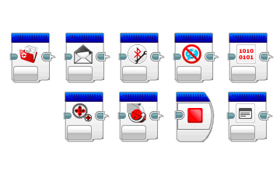
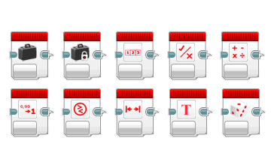
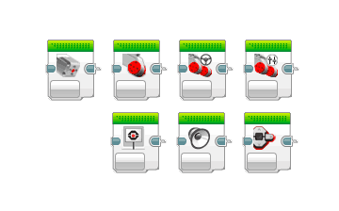
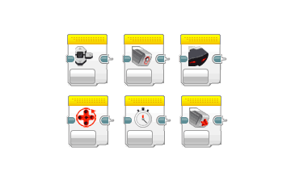
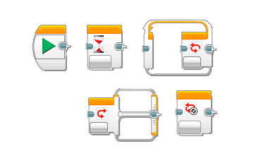
Space Junk

Slide 2
My Helpful Opinion In My Own Words
Some of space junk is valuable because: There are rare Metals in some of the space junk that can be used again , and others just burn up like for example : Glass , plastic , wire ,some metals , satellite dishes , gold foil ect. So they can’t be used again like the other materials that don’t
Burn up . So making the space junk come in like a comet is a bad idea ,
and it can get out of hand . So in conclusion bringing space junk in like
A comet is a bad idea , we should just bring space junk in like a rocket or a Space shuttle or something like that .

Slide 3
This is an animated
version of my space
junk collector. As any
other net space junk
collector mine will
do to orbits around
the Earth before
Switching with a
net with smaller
holes to pick up
smaller space junk.
Here are some more
of pictures that will
probably give us an
Idea
THANK YOU SO MUCH!

Slide 4
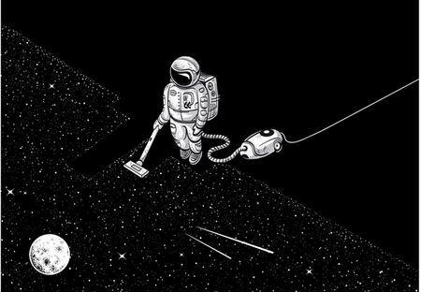
CRAZY
IDEAS

